Slide 1


Slide 2
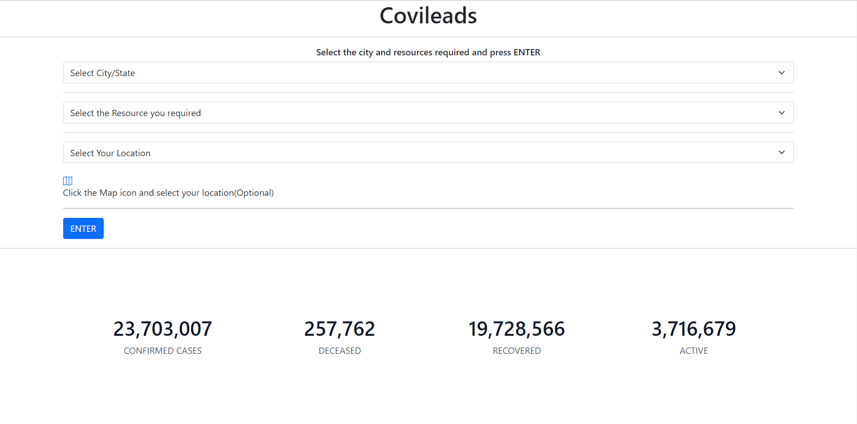
So, this is the front page of our website !!! It contains some details that the visitor has to fill for the resources he required and live corona cases.

Slide 3
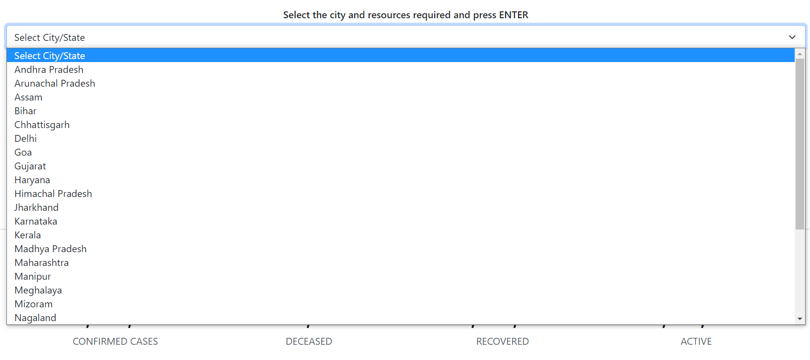
Select the city/state you live in

Slide 4
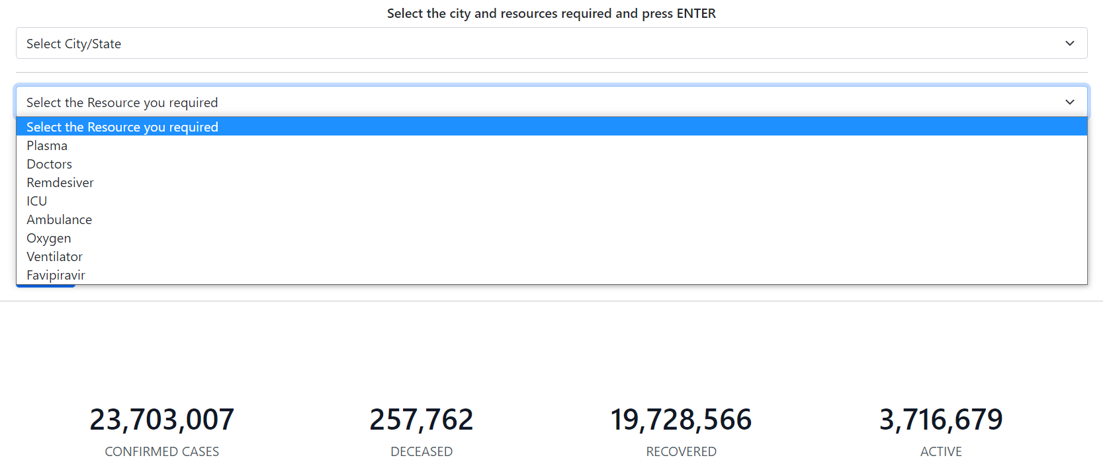
Then select the resource you required like plasma, ICU beds, Remdesivir, etc

Slide 5

This is optional for the visitor he/she can click the map icon and select his current location, so that the website can get more clarity and give the details accordingly.
Map icon

Slide 6
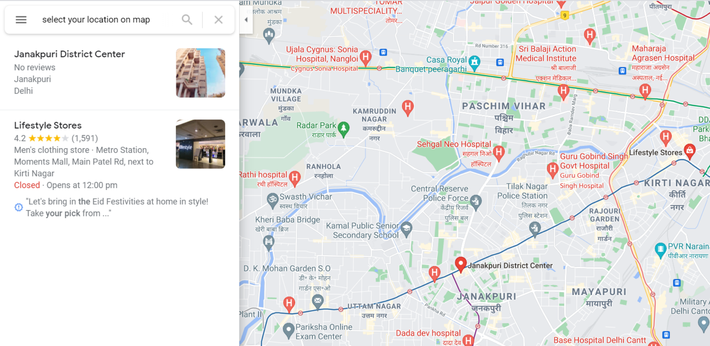
Now select your location and go back to the home page.

Slide 7

Now press the enter button and you will be provided with the details for the resource you have selected !

Slide 8
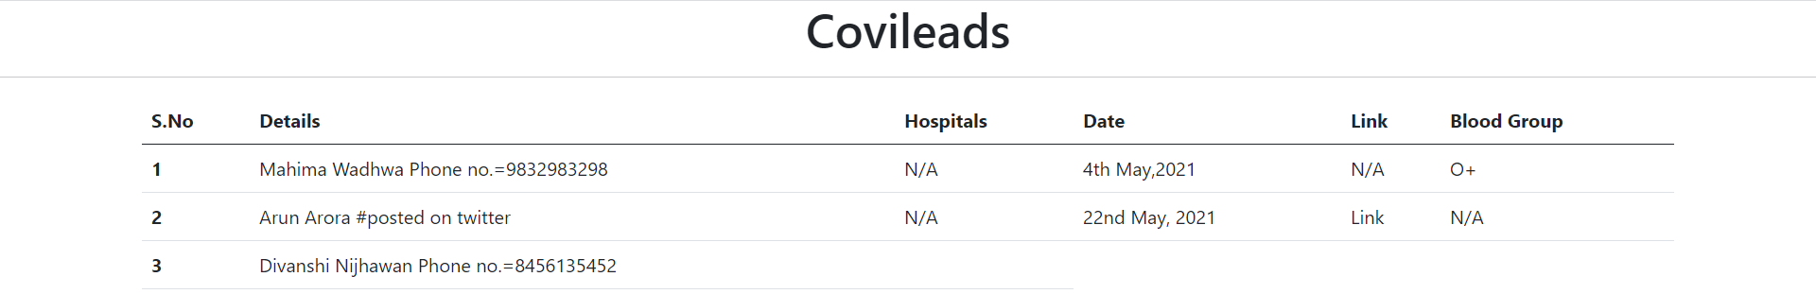

This is just a small example of how the resources will be provided to the user.
It will be containing the details that are there in the database. Direct links from twitter can also be provided from the trusted ones.
If you require any other resource go back to the home page and you will be provided with the details.

Slide 9
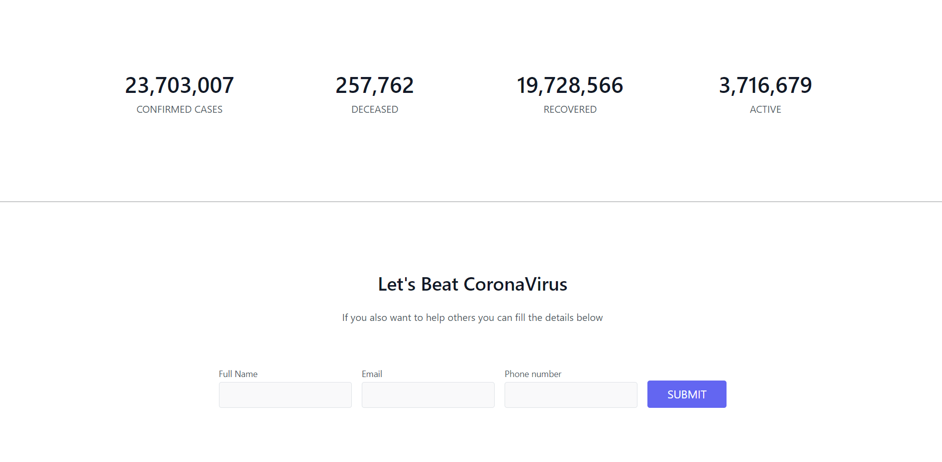

User can also fill the details if he/she can help in such resources by filling up a small form and submit it. The details will be provided in the database and can help the other person.

